Slide 1

MANAGING DATA TERM PROJECT PROPOSAL
NYC NEIGHBOURHOOD INSIGHTS PLATFORM
GROUP 8: KHUSHI MANDAVIA, NIVEDITHA H. GIRISH, SHIVI TANDON, SHIVANI SINGH, TANAY DEEP GUPTA, TANVI DINESH NANDU

Slide 2

NYC AT YOUR FINGERTIPS
Think of our NYC Neighborhood Insights Platform as a digital compass aimed at demystifying NYC's five boroughs—Queens, The Bronx, Manhattan, Staten Island, and Brooklyn. It's designed to serve as an all-encompassing guide, akin to having a local New Yorker by your side.
What Sets Us Apart:
Hyper-Localized Information: Dive into the heart of each neighborhood with insights from reliable and exhaustive data, including housing prices, crime statistics, and neighborhood amenities.
Dynamic Search Interface: Enter a borough name or zip code and unlock a trove of insights—from the bustling streets of Manhattan to the serene suburbs of Staten Island.
User-Centric Design: Whether you're a student seeking affordable housing, a tourist exploring the city, a family looking for a vibrant community, or an investor analyzing market potential, our platform curates information tailored to your needs.
Interactive Visualizations & AI Chatbot: Engaging maps and charts provide clear visualizations of data, simplifying interpretation and comparison between neighborhoods, complemented by an AI-powered chatbot that delivers precise information based on user queries.

Slide 3




WHO IS NYC INSIGHTS PLATFORM FOR?
RELOCATORS
INVESTORS
URBAN PLANNERS/
BUSINESSES
VISITORS
NEW YORKERS

Slide 4

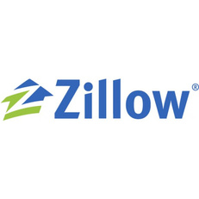

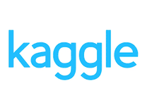




DATA SOURCING
Our project utilizes publicly available data from municipal and state databases, real estate listings, Kaggle datasets, and demographic surveys. We've gathered borough-level information from these sources and, where possible, enhanced our platform with zip code-level data for greater detail.
HOUSING
TRANSPORTATION & ACCESSIBILITY
ENTERTAINMENT &
RECREATION
BOROUGH
VISUALS
CRIME
STATISTICS
DEMOGRAPHICS
HEALTH
EDUCATION
UTILITIES
LINK TO DATA SOURCES

Slide 5



TECHNOLOGY EMPLOYED AND RATIONALE
Structured Data Efficiency: Manages structured data like housing prices & crime statistics with high querying efficiency
Data Management Tool: Integral for loading tabular data such as lists of hospitals, parks, and restaurants onto the front end.
Cost-Effectiveness: Meets our startup's budget requirements for low-cost infrastructure, essential for sustainable scaling.
Geospatial Capabilities: Supports expansion with geospatial database features, enabling location-based services and insights as we scale.
Optimized for Unstructured Data: MongoDB excels in handling unstructured data like images, offering schema flexibility and efficient data retrieval.
Scalable Storage with GridFS: Employs GridFS to manage large files, ensuring seamless storage and access to extensive image datasets, facilitating ongoing content updates and expansions.
Transformation: to transform and clean structured data such as housing prices, crime statistics, and other tabular data.
Wrapper to connect with databases in MongoDB and PostgreSQL

Slide 6



TECHNOLOGY EMPLOYED AND RATIONALE
Interactive Data Access: Seamlessly integrates with multiple data tables such as lists of hospitals, parks, and restaurants allowing the chatbot to dynamically access and utilize specific datasets for real-time responses.
Dynamic Query Processing: Supports advanced natural language understanding, enabling the chatbot to accurately interpret and respond to user queries.
Optimized Performance: Employs a scalable architecture that efficiently handles increased data volumes and user interactions, ensuring robust performance as demand grows.
Interactive Displays: Builds custom graphs and heatmaps for real-time data visualization on housing and crime statistics.
Dynamic User Inputs: Implements dropdowns for selecting boroughs or zip codes, auto-updating visuals and tables.
Optimized Layouts: Utilizes Dash along with HTML and CSS for intuitive, device-responsive designs that enhance user navigation and aesthetics.

Slide 7
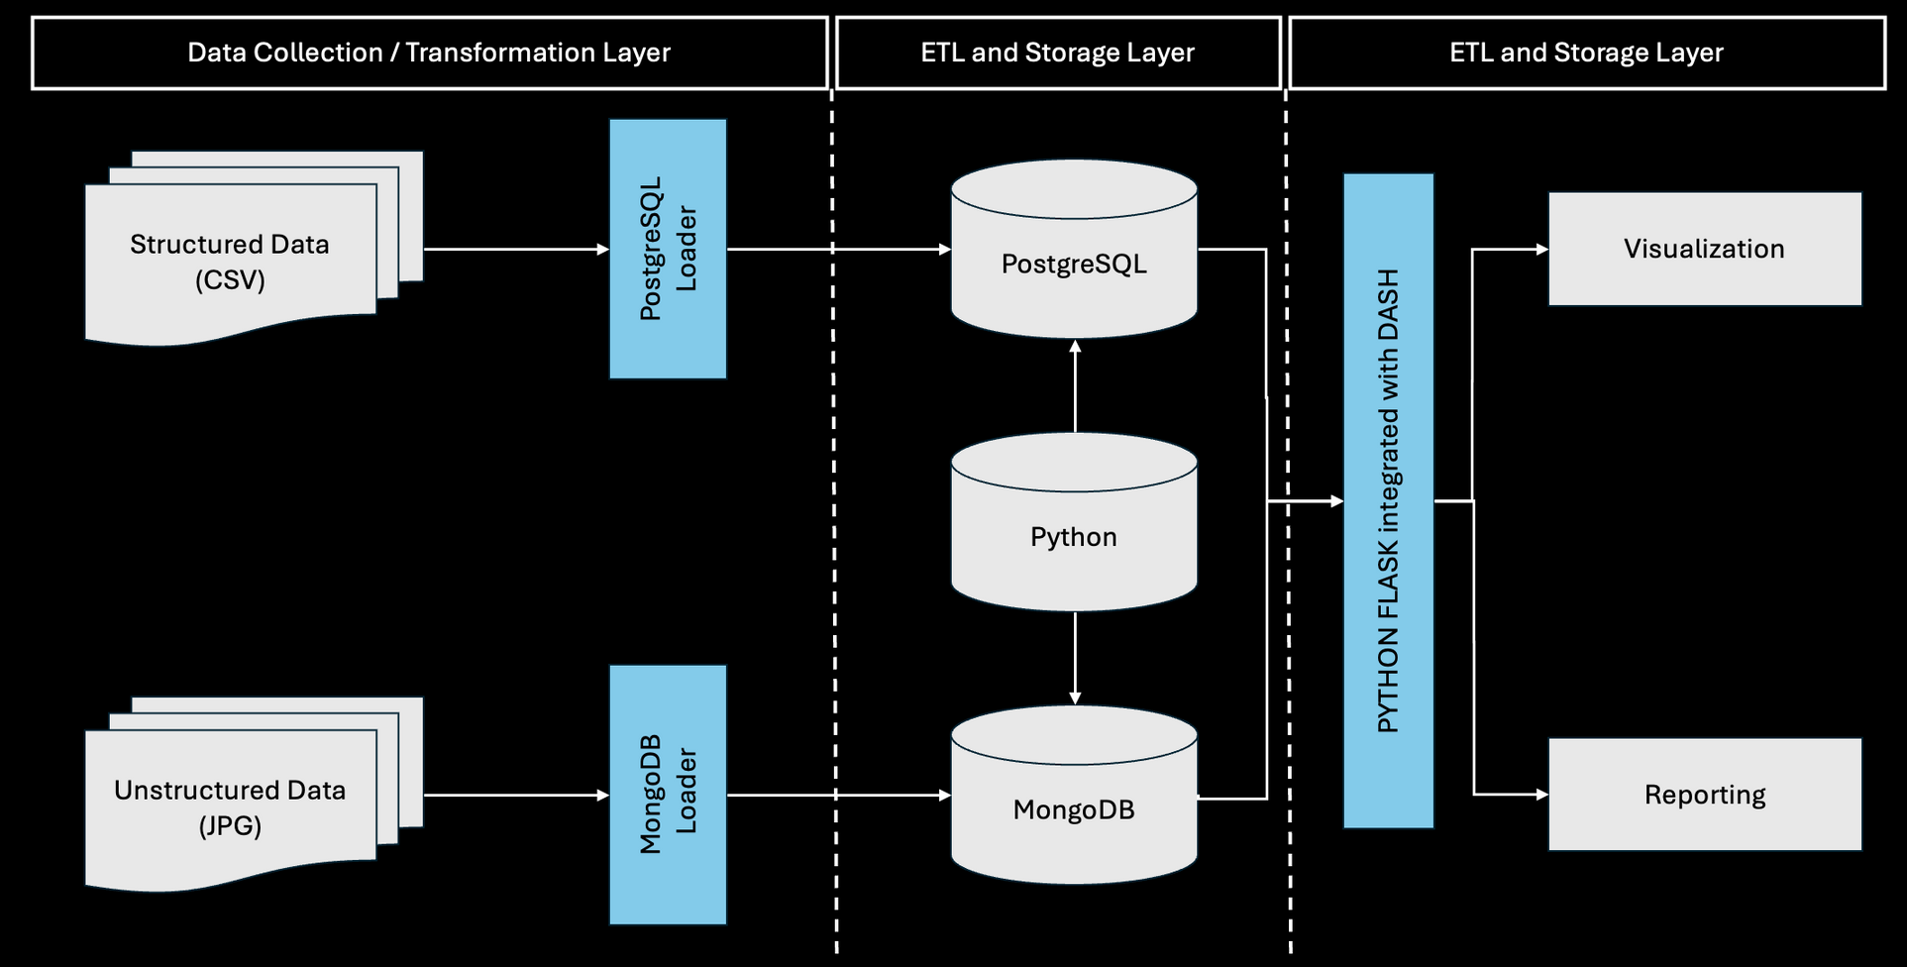
WORKFLOW DESIGN

Slide 8
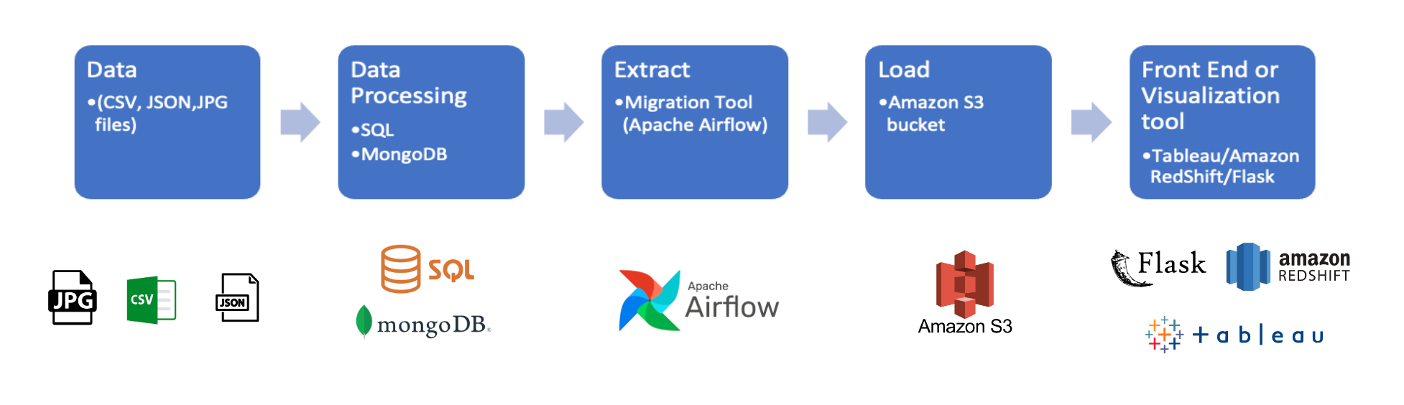
ETL PIPELINE: TO BE IMPLEMENTED FOR SCALABILITY

Slide 9
OPERATIONAL SCALABILITY
DATA AUTOMATION:
Apache Airflow: Deploy Apache Airflow to manage and automate the data workflows, orchestrating tasks like data extraction, transformation, and loading (ETL). This will allow for scheduled updates from various data sources, ensuring that the platform provides the most current information without manual intervention.
Amazon S3: Use Amazon S3 for data storage, leveraging its scalability and durability. This ensures that as the volume of data grows, the platform can seamlessly scale storage needs. S3 also provides benefits like data redundancy, ensuring high availability and disaster recovery.
LOAD BALANCING:
Implement advanced load balancing techniques using solutions like AWS Elastic Load Balancing or similar technologies. This will distribute incoming user requests across multiple server instances to prevent any single server from being overwhelmed, thereby maintaining optimal performance and minimizing response times even during peak loads.
PERFORMANCE OPTIMIZATION:
Regularly conduct performance tuning and updates to the software and infrastructure. This includes optimizing database queries, caching frequently accessed data, and implementing efficient data retrieval methods to reduce latency.
MODULAR DESIGN:
Design the system architecture in a modular fashion where different components like user interface, database management, and data processing can be developed and scaled independently. This flexibility allows for targeted upgrades and scaling on specific sections of the platform without needing to overhaul the entire system.
Employ microservices architecture where feasible to encapsulate different functionalities, making the system more resilient & easier to manage.
SCHEMA - REFERENTIAL INTEGRATION:
THE ATTEMPT TO MAP EVERY DATASET BY BOROUGH USING A 'BOROUGH_ID' WAS PARTIALLY UNSUCCESSFUL BECAUSE SOME DATASETS DID NOT SPECIFY BOROUGHS, AND THEY COULD NOT BE MAPPED BY ZIPCODE EITHER. CURRENTLY, THE SYSTEM IS SET TO READ-ONLY MODE, WHICH DOES NOT REQUIRE A SCHEMA. HOWEVER, WHEN WRITE WRITE PRIVILEGES ARE EVENTUALLY GRANTED, IT WILL BE NECESSARY TO IMPLEMENT A STAR SCHEMA AND ENSURE REFERENTIAL INTEGRITY TO MAINTAIN DATA CONSISTENCY.

Slide 10







STRATEGIC SCALABILITY
This involves planning and executing growth strategies that will allow the business to expand markets and customer bases effectively. This strategic foresight ensures that the company remains aligned with market needs and technological advances.
FRIENDS LOCATION NETWORK
UI-UX INTERACTIVE FEATURES
MARKET
EXPANSION
GRANULAR
VIEW OF NEIGHBORHOODS
MOBILE
APPLICATION
‘NEAR ME’ FEATURE
(GOOGLE MAPS API)
AD REVENUE MONETISATION

Slide 11












COST IMPLICATIONS
Category
Monthly Cost
Details
Mongo DB
Licensed softwares
$60 per month
10GB to 4TB of storage
Tableau
$75 per user per month
Tableau Creator
Amazon S3
Cloud Storage & Hosting
$1,177.6 per month
50TB of storage per month
Amazon Redshift
$3,504 per month
Memory: 244 GiB
Data Acquisition
Data Acquisition
$0 per month
Data is being derived from public source with no cost implications
$250 per month
Mega package pricing to access an extensive ecosystem to accelerate our development process
Data Acquisition
API
AWS Elastic Load Balancer
Load Balancing
$22.42 per month
Application Load Balancer ($0.03114 * 24 hours * 30 days).
Google Maps API
Future Scalability
$200 per month
Google Maps API integration for ‘Near Me’ feature
Website
Website Design, Development. Maintenence
$500 per month
TOTAL MONTHLY COST
$5984.02 per month

Slide 12





DATA QUALITY DIMENSIONS
Accuracy
Consistency
Validity
Source verification: use of official sources where possible; regular reliability and credibility checks of data sources
Implement Centralized Database Management System
Use software tools and machine learning algorithms to automate the validation process, flagging anomalies and inconsistencies
Completeness
Timeliness
Uniqueness
Implement systematic data quality checks for completeness
Real-time monitoring: implement API connection and monitor data streams in real-time
Implement de-duplication processes that identify and merge or remove duplicate entires

Slide 13
LIMITATIONS OF THE CURRENT PROTOTYPE
Data Granularity: The prototype provides borough and zip code-level insights but lacks address-specific detail
Real-Time Updates: Data refreshes are not fully automated, potentially leading to lags in information accuracy
System Capacity: Current infrastructure may not support a surge in concurrent users, affecting performance
Advanced Features: Certain planned functionalities like an extensive ‘Near Me’ feature are not yet implemented
that can make the application more user-friendly and comprehensive
RESOLUTIONS WITH INCREASED FUNDING
Enhanced Data Precision: Investment will enable the integration of address-specific data, providing hyper-local insights
Automation of Data Pipelines: Funds will be allocated to develop sophisticated ETL processes for real-time data updates
Infrastructure Upgrade: Increased capital will be used to scale server capabilities and cloud services to handle user load efficiently
Advanced Features: Certain planned functionalities like an extensive ‘Near Me’ feature are not yet implemented
that can make the application more user-friendly and comprehensive

Slide 14
PERFORMANCE MEASUREMENT
User Engagement Metrics: Track active users, session duration, and interaction rates to gauge and improve engagement
System Uptime and Responsiveness: Monitor server uptime and response times to ensure reliability and speed
Data Accuracy Audits: Regular verification against authoritative sources to maintain high data accuracy standards
Feedback Loops: Implement user feedback mechanisms to continuously refine the user experience

Slide 15

As we conclude, we invite you to envision a future where the vast mosaic of New York City's neighborhoods is seamlessly navigable right at your fingertips. Our NYC Neighborhood Insights Platform stands as a testament to the power of data, technology, and user-centric design. From the granular details of housing prices to the vibrant tapestry of community life, each feature of our platform is crafted to empower decision-making, foster community engagement, and enhance the urban experience for residents and visitors alike.
Thank you for joining us on this journey of discovery and innovation.

Slide 16
MANAGING DATA TERM PROJECT PROPOSAL
THANKYOU
LINK TO THE TEAM AGREEMENT

